Slide 1

Amrutvahini College of Engineering, Sangamner
Department of Computer Engineering
UNIT-5
Synchronization and Concurrency Control
By: Dr. Panhalkar A. R.

Slide 2
Syllabus
Concurrency: Principle and issues with Concurrency, Mutual Exclusion, Hardware approach, Software approach, Semaphore, Mutex and monitor, Reader writer problem, Producer Consumer problem, Dining Philosopher problem.
Deadlocks: Principle of Deadlock, Deadlock prevention, Deadlock avoidance, Deadlock detection, Deadlock recovery.
Reference Book: Silberschatz, Galvin, Gagne, "Operating System Principles", 9th Edition, Wiley, ISBN 978-1-118-06333-0

Slide 3
Course Objective
To study and analyze aspects of concurrency and deadlocks in operating system.
Course Outcome
Analyze the concepts of concurrency control and interpret deadlock handling in OS.

Slide 4

Inter Process Communication

Slide 5

Interprocess Communication (IPC)
Exchange of data between two or more separate, independent processes/threads.
Operating systems provide facilities/resources for inter-process communications (IPC), such as message queues, semaphores, and shared memory.
Why do processes communicate?
To share resources
Client/server paradigms
Inherently distributed applications
Reusable software components
Other good software engineering reasons

Slide 6
Multiple Processes
Operating System design is concerned with the management of processes and threads:
Multiprogramming
Multiprocessing
Distributed Processing
Big Issue is Concurrency
Managing the interaction of all of these processes
Notes:
The central themes of operating system design are all concerned with the management of processes and threads:
• Multiprogramming: The management of multiple processes within a uniprocessor system
• Multiprocessing : The management of multiple processes within a multiprocessor
• Distributed processing: The management of multiple processes executing on multiple, distributed computer systems. The recent proliferation of clusters is a prime example of this type of system.

Slide 7

Concurrency
What is Concurrency? How it differs from parallelism?
“Concurrency means executing multiple tasks at the same time but not necessarily simultaneously. “
There are two tasks executing concurrently, but those are run in a 1-core CPU, so the CPU will decide to run a task first and then the other task or run half a task and half another task, etc.
Two tasks can start, run, and complete in overlapping time periods i.e Task-2 can start even before Task-1 gets completed. It all depends on the system architecture.

Slide 8
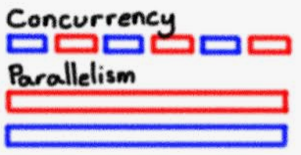
Concurrency
“Parallelism means executing multiple tasks at the same time simultaneously. “
It literally physically run parts of tasks OR multiple tasks, at the same time using the multi-core infrastructure of CPU, by assigning one core to each task or sub-task.

Slide 9
Arises in Three Different Contexts:
Concurrency
Multiple Applications
invented to allow processing time to be shared among active applications
Structured Applications
extension of modular design and structured programming
Operating System Structure
OS themselves implemented as a set of processes or threads
Notes:
Fundamental to all of these areas, and fundamental to OS design, is concurrency. Concurrency encompasses a host of design issues, including communication among processes, sharing of and competing for resources (such as memory, files, and I/O access), synchronization of the activities of multiple processes, and allocation of processor time to processes. We shall see that these issues arise not just in multiprocessing and distributed processing environments but even in single-processor multiprogramming systems.
Concurrency arises in three different contexts:
• Multiple applications: Multiprogramming was invented to allow processing time to be dynamically shared among a number of active applications.
• Structured applications: As an extension of the principles of modular design and structured programming, some applications can be effectively programmed as a set of concurrent processes.
Operating system structure: The same structuring advantages apply to systems programs, and we have seen that operating systems are themselves often implemented as a set of processes or threads.

Slide 10
Principles of Concurrency
Interleaving and overlapping
can be viewed as examples of concurrent processing
both present the same problems
In multiprogramming, the relative speed of execution of processes cannot be predicted
depends on activities of other processes
the way the OS handles interrupts
scheduling policies of the OS
Notes:
At first glance, it may seem that interleaving and overlapping represent fundamentally different modes of execution and present different problems. In fact, both techniques can be viewed as examples of concurrent processing, and both present the same problems. In the case of a uniprocessor, the problems stem from a basic characteristic of multiprogramming systems: The relative speed of execution of processes cannot be predicted. It depends on the activities of other processes, the way in which the OS handles interrupts, and the scheduling policies of the OS.

Slide 11

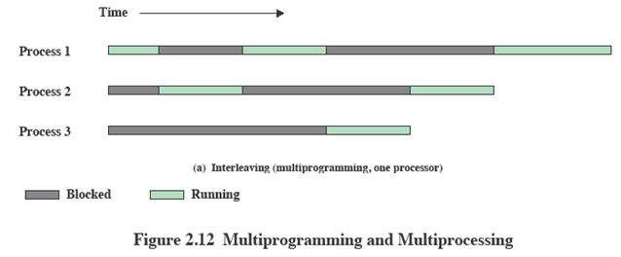
Interleaving and Overlapping Processes
Principles and issues with concurrency
Earlier we saw that processes may be interleaved on uniprocessors

Slide 12
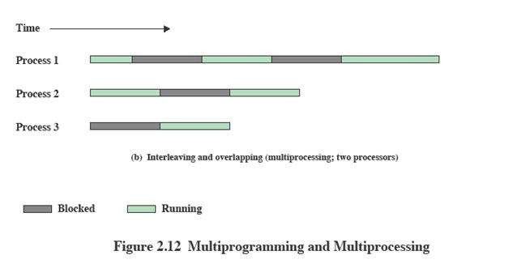
Interleaving and Overlapping Processes
Principles and issues with concurrency
And not only interleaved but overlapped on multi-processors

Slide 13
Concurrency
Concurrent access to shared data may result in data inconsistency.
Maintaining data consistency requires mechanisms to ensure the orderly execution of cooperating processes.

Slide 14
Difficulties of Concurrency
Sharing of global resources
Difficult for the OS to manage the allocation of resources optimally
Difficult to locate programming errors as results are not deterministic and reproducible
Notes:
The following difficulties arise:
1. The sharing of global resources is fraught with peril. For example, if two processes both make use of the same global variable and both perform reads and writes on that variable, then the order in which the various reads and writes are executed is critical. An example of this problem is shown in the following subsection.
2. It is difficult for the OS to manage the allocation of resources optimally. For example, process A may request use of, and be granted control of, a particular I/O channel and then be suspended before using that channel. It may be undesirable for the OS simply to lock the channel and prevent its use by other processes; indeed this may lead to a deadlock condition, as described in Chapter 6 .
3. It becomes very difficult to locate a programming error because results are typically not deterministic and reproducible (e.g., see [LEBL87, CARR89, SHEN02] for a discussion of this point).
All of the foregoing difficulties present themselves in a multiprocessor system as well, because here too the relative speed of execution of processes is unpredictable. A multiprocessor system must also deal with problems arising from the simultaneous execution of multiple processes. Fundamentally, however, the problems are the same as those for uniprocessor systems. This should become clear as the discussion proceeds.

Slide 15
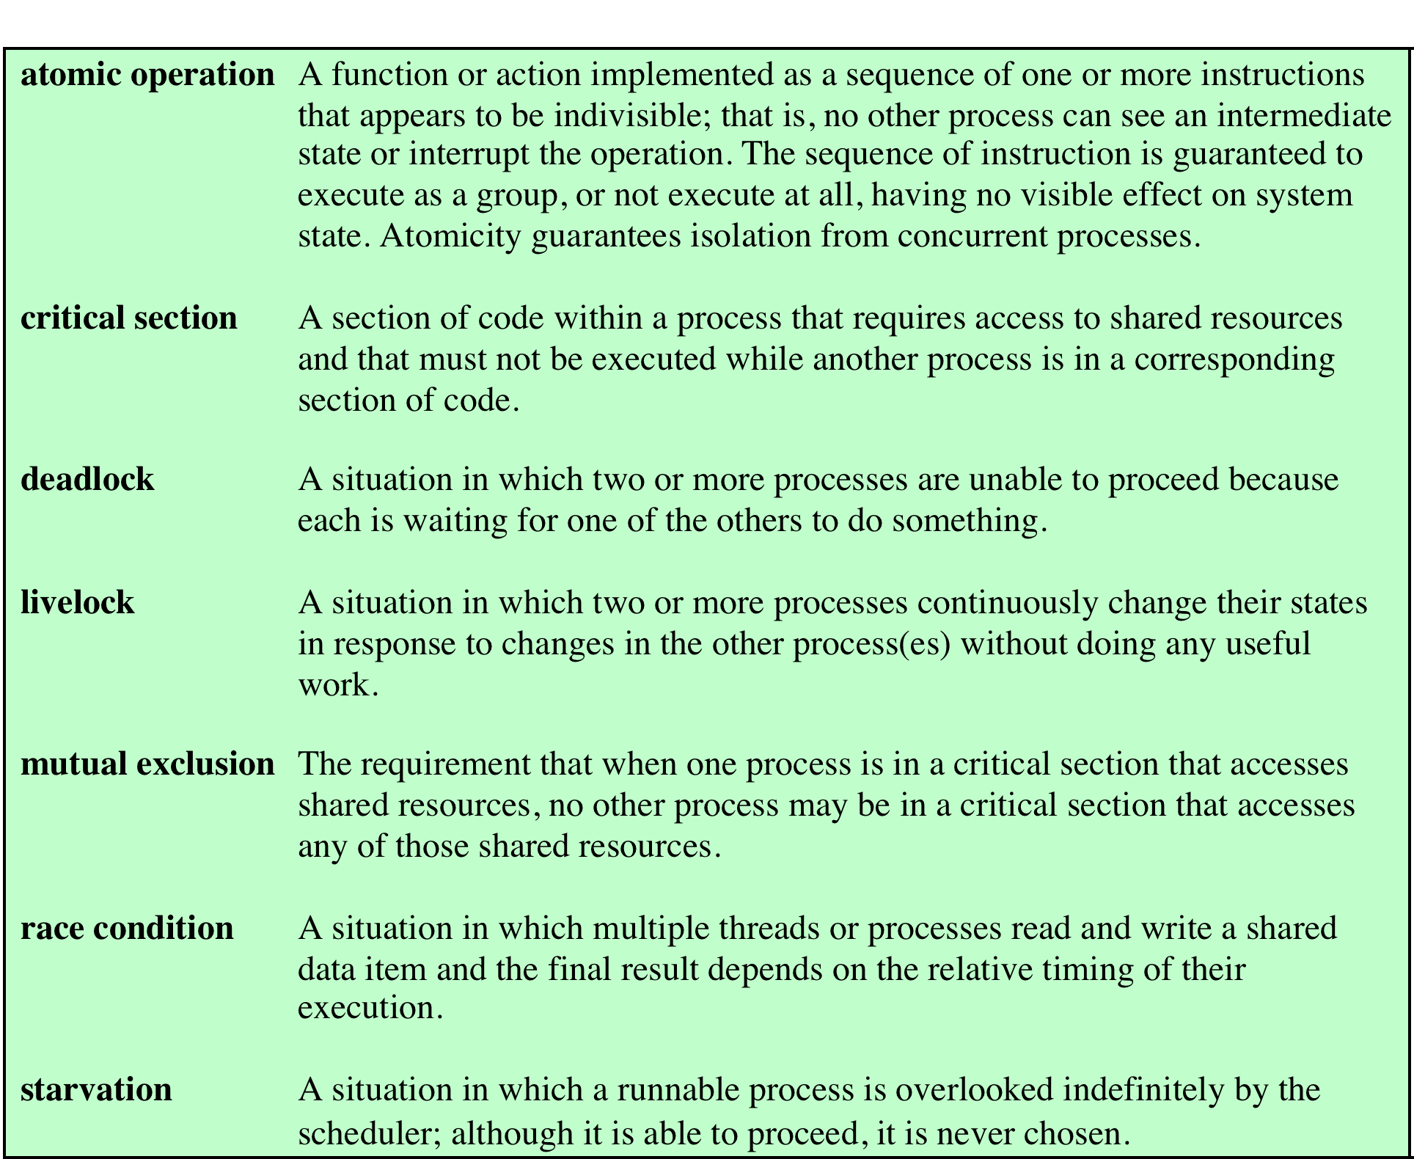
Key Terms
Table 5.1 Some Key Terms Related to Concurrency
Notes:
Key terms related to concurrency.

Slide 16
Concurrency & Shared Data
Concurrent processes may share data to support communication, info exchange,...
Threads in the same process can share global address space
Concurrent sharing may cause problems
For example: lost updates

Slide 17
Operating System Concerns
Design and management issues raised by the existence of concurrency:
The OS must:
be able to keep track of various processes
allocate and de-allocate resources for each active process
protect the data and physical resources of each process against interference by other processes
ensure that the processes and outputs are independent of the processing speed
Notes:
What design and management issues are raised by the existence of concurrency?
We can list the following concerns:
1. The OS must be able to keep track of the various processes. This is done with the use of process control blocks and was described in Chapter 4 .
2. The OS must allocate and de-allocate various resources for each active process.
At times, multiple processes want access to the same resource. These resources include
• Processor time: This is the scheduling function, discussed in Part Four.
• Memory: Most operating systems use a virtual memory scheme. The topic is addressed in Part Three.
• Files: Discussed in Chapter 12 .
• I/O devices: Discussed in Chapter 11 .
3. The OS must protect the data and physical resources of each process against
unintended interference by other processes. This involves techniques that relate to memory, files, and I/O devices. A general treatment of protection is found in Chapter 14 .
4. The functioning of a process, and the output it produces, must be independent
of the speed at which its execution is carried out relative to the speed of other
concurrent processes. This is the subject of this chapter.

Slide 18

Race Condition
Occurs when multiple processes or threads read and write shared data items
The final result depends on the order of execution
the “loser” of the race is the process that updates last and will determine the final value of the variable
Notes:
A race condition occurs when multiple processes or threads read and write data items so that the final result depends on the order of execution of instructions in the multiple processes. Let us consider two simple examples.
As a first example, suppose that two processes, P1 and P2, share the global variable a . At some point in its execution, P1 updates a to the value 1, and at some point in its execution, P2 updates a to the value 2. Thus, the two tasks are in a race to write variable a . In this example, the “loser” of the race (the process that updates last) determines the final value of a .
For our second example, consider two process, P3 and P4, that share global variables b and c , with initial values b = 1 and c = 2 . At some point in its execution, P3 executes the assignment b = b + c , and at some point in its execution, P4 executes the assignment c = b + c . Note that the two processes update different variables. However, the final values of the two variables depend on the order in which the two processes execute these two assignments. If P3 executes its assignment statement first, then the final values are b = 3 and c = 5 . If P4 executes its assignment statement first, then the final values are b = 4 and c = 3 .
Appendix A includes a discussion of race conditions using semaphores as an example.

Slide 19
A Simple Example
Assume P1 and P2 are executing this code and share the variable a
Processes can be preempted at any time.
Assume P1 is preempted after the input statement, and P2 then executes entirely
The character echoed by P1 will be the one read by P2 !!
static char a;
void echo()
{
cin >> a;
cout << a;
}

Slide 20
What’s the Problem?
This is an example of a race condition
Individual processes (threads) execute sequentially in isolation, but concurrency causes them to interact.
Need to prevent concurrent execution by processes when they are changing the same data. We need to enforce mutual exclusion.

Slide 21
The Critical Section Problem
When a process executes code that manipulates shared data (or resources), we say that the process is in its critical section (CS) for that shared data
We must enforce mutual exclusion on the execution of critical sections.
Only one process at a time can be in its CS (for that shared data or resource)
The CS problem exists on multiprocessors as well as on uniprocessors.
.

Slide 22
The Critical Section Problem
n processes all competing to use some shared data
Each process has a code segment, called critical section, in which the shared data is accessed.
Problem – ensure that when one process is executing in its critical section, no other process is allowed to execute in its critical section.

Slide 23
Solution to Critical-Section Problem
Requirements:
Mutual Exclusion - If process P_{i} is executing in its critical section, then no other processes can be executing in their critical sections.
Progress - If no process is executing in its critical section and there exist some processes that wish to enter their critical section, then the selection of the processes that will enter the critical section next cannot be postponed indefinitely.
3. Bounded Waiting - A bound must exist on the number of times that other processes are allowed to enter their critical sections after a process has made a request to enter its critical section and before that request is granted.
Assume that each process executes at a nonzero speed
No assumption concerning relative speed of the N processes

Slide 24
Initial Attempts to Solve Problem
Only 2 processes, P₀ and P₁
General structure of process P_{i} (other process P_{j})
do {
entry section
critical section
exit section
reminder section
} while (1);
Processes may share some common variables to synchronize their actions.
entry section: requests entry to CS
exit section: notifies that CS is completed
remainder section (RS): code that does not involve shared data and resources.

Slide 25
Algorithm 1
Shared variables:
int turn; initially turn = 0
turn = i ⇒ P_{i} can enter its critical section
Process P_{i}
do {
while (turn != i) ;
critical section
turn = j;
reminder section
} while (1);
Satisfies mutual exclusion, but not progress

Slide 26
Algorithm 2
Shared variables
boolean flag[2]; initially flag [0] = flag [1] = false.
flag [i] = true ⇒ P_{i} ready to enter its critical section
Process P_{i}
do {
flag[i] := true; while (flag[j]) ; critical section
flag [i] = false;
remainder section
} while (1);
Satisfies mutual exclusion, but not progress requirement.

Slide 27
Peterson’s Solution : Software approach
Two process solution.
Combined shared variables of algorithms 1 and 2.
Assume that the LOAD and STORE instructions are atomic; that is, cannot be interrupted.
The two processes share two variables:
int turn;
Boolean flag[2]
The variable turn indicates whose turn it is to enter the critical section.
The flag array is used to indicate if a process is ready to enter the critical section. flag[i] = true implies that process P_{i} is ready!

Slide 28
Algorithm 3
Process P_{i}
do {
flag [i]:= true; turn = j; while (flag [j] and turn = j) ;
critical section
flag [i] = false;
remainder section
} while (1);
Meets all three requirements : mutual exclusion, progress and bounded waiting; solves the critical-section problem for two processes.
Drawback: Only applicable to two processes. so not applicable for modern computers

Slide 29
Synchronization: Hardware Approach
The hardware-based solution to critical section problem is based on a simple tool i.e. lock.
Solutions to the critical-section problem all have one minimum requirement
This requirement is a lock
Locks prevent race conditions
This is because a process must acquire the lock before entering its critical section and release the lock after exiting its critical section

Slide 30
Solution to Critical-section Problem Using Locks
General solution to the critical-section problem emphasizing the use of locks to prevent race conditions
Algorithm:
do {
acquire lock
critical section
release lock
remainder section
} while (TRUE);

Slide 31
Synchronization: Hardware Approach
Many systems provide hardware support for critical section code
This makes programming easier
Also makes the overall system more efficient
Uniprocessors (single processor system)
When shared variables are being modified, the processor disables interrupts
Currently running code executes without preemption
Unfortunately, this approach is inefficient on multiprocessor systems
Reason is because messages have to be passed to all processors whenever shared variables are being modified
All these excess messages slow down the operating system

Slide 32
Synchronization: Hardware Approach
Modern machines provide special atomic hardware instructions
Atomic = non-interruptible
Atomic means that a certain group of instructions cannot be interrupted
In other words, several instructions form one uninterruptible unit
For example, the machine instructions for ++count can be implemented atomically in the CPU as one uninterruptible unit
register1 = count
register1 = register1 + 1
count = register1
This is often the approach taken by nonpreemptive kernels.
Unfortunately, this solution is not as feasible in multiprocessor environment.

Slide 33
Synchronization: Hardware Approach
There are three algorithms in the hardware approach of solving Process Synchronization problem:
Test and Set
Swap
Unlock and Lock

Slide 34
Test And Set Instruction
Special hardware instruction : TestAndSet
It is defined as
boolean TestAndSet (boolean *target)
{
boolean rv = *target;
*target = TRUE;
return rv;
}
Must be executed atomically
do {
while ( TestAndSet (&lock )) ;
// do nothing
// Enter critical section
lock = FALSE;
// remainder section
} while (true);

Slide 35
Shared Data
False
LOCK
I want to enter Critical Section
P1
P2

Slide 36
Shared Data
False
LOCK
TestAndSet (&LOCK)
P1
P2

Slide 37
Shared Data
TRUE
LOCK
Return(False) //previous value of lock
Then SET LOCK=TRUE
P1
P2

Slide 38
Shared Data
TRUE
LOCK
Access
Hey!! I am entering critical Section
P1
P2

Slide 39
Shared Data
TRUE
LOCK
Access
I want to enter Critical Section
P1
P2

Slide 40
Shared Data
TRUE
LOCK
Access
TestAndSet (&LOCK)
P1
P2

Slide 41
Shared Data
//previous value of lock
TRUE
LOCK
Return(TRUE)
SET LOCK=TRUE
Access
P1
P2

Slide 42
Shared Data
//previous value of lock
TRUE
LOCK
Return(TRUE)
SET LOCK=TRUE
Access
OHH!!!
LOCK=TRUE
I have to wait
P1
P2

Slide 43
Shared Data
//previous value of lock
TRUE
LOCK
Return(TRUE)
SET LOCK=TRUE
My critical section completed
OHH!!!
LOCK=TRUE
I have to wait
P1
P2

Slide 44
Shared Data
FALSE
LOCK
Make LOCK=FALSE
P1
P2

Slide 45
Shared Data
FALSE
LOCK
TestAndSet (&LOCK)
P1
P2

Slide 46
Shared Data
//previous value of lock
TRUE
LOCK
Return(FALSE)
SET LOCK=TRUE
P1
P2

Slide 47
Shared Data
TRUE
LOCK
Access
Hey!! I am entering critical Section
P1
P2

Slide 48
Test And Set Instruction
The TestAndSet() hardware instruction is atomic instruction.
Atomic means both the test operation and set operation are executed in one machine cycle at once.
If the two different processes are executing TestAndSet() simultaneously each on different CPU.
Still, they will be executed sequentially in some random order.
globally declare a Boolean variable lock and initialize it to false.

Slide 49
Test And Set Instruction
The first process will enter the critical section at once as TestAndSet(lock) will return false and it’ll break out of the while loop.
The other processes cannot enter now as lock is set to true and so the while loop continues to be true. Mutual exclusion is ensured.
Once the first process gets out of the critical section, lock is changed to false.
So, now the other processes can enter one by one. Progress is also ensured.
However, after the first process any process can go in.
There is no queue maintained, so any new process that finds the lock to be false again, can enter. So bounded waiting is not ensured.

Slide 50
Swap Instruction
Swap algorithm is a lot like the TestAndSet algorithm.
Instead of directly setting lock to true in the swap function, key is set to true and then swapped with lock.
So, again, when a process is in the critical section, no other process gets to enter it as the value of lock is true.
Mutual exclusion is ensured. Again, out of the critical section, lock is changed to false, so any process finding it gets to enter the critical section. Progress is ensured.
However, again bounded waiting is not ensured for the very same reason.

Slide 51
Swap Instruction
Definition:
void Swap (boolean *a, boolean *b)
{
boolean temp = *a;
*a = *b;
*b = temp:
}
Shared Boolean variable lock initialized to FALSE;
Each process has a local Boolean variable key
do {
key = TRUE;
while ( key == TRUE)
Swap (&lock, &key );
// critical section
lock = FALSE;
// remainder section
} while (TRUE);

Slide 52
Shared Data
False
LOCK
I want to enter Critical Section
KEY
P1
P2
KEY

Slide 53
Shared Data
False
LOCK
I want to enter Critical Section
TRUE
KEY
P1
P2
KEY

Slide 54
Shared Data
False
LOCK
SWAP
TRUE
KEY
P1
P2
KEY

Slide 55
Shared Data
TRUE
LOCK
Access
Hey!! I am entering critical Section
FALSE
KEY
P1
P2
KEY

Slide 56
Shared Data
TRUE
LOCK
Access
I want to enter Critical Section
FALSE
KEY
P1
P2
KEY

Slide 57
Shared Data
TRUE
LOCK
Access
I want to enter Critical Section
FALSE
TRUE
KEY
P1
P2
KEY

Slide 58
Shared Data
TRUE
LOCK
SWAP
Access
FALSE
TRUE
KEY
P1
P2
KEY

Slide 59
Shared Data
TRUE
LOCK
SWAP
Access
OHH!!!
No change..
I have to wait
FALSE
TRUE
KEY
P1
P2
KEY

Slide 60
Shared Data
TRUE
LOCK
SWAP
My critical section completed
OHH!!!
No change..
I have to wait
FALSE
TRUE
KEY
P1
P2
KEY

Slide 61
Shared Data
TRUE
LOCK
Make LOCK=FALSE
SWAP
FALSE
TRUE
KEY
P1
P2
KEY

Slide 62
Shared Data
FALSE
LOCK
SWAP
FALSE
TRUE
KEY
P1
P2
KEY

Slide 63
Shared Data
TRUE
LOCK
SWAP
FALSE
FALSE
KEY
P1
P2
KEY

Slide 64
Shared Data
TRUE
LOCK
ACCESS
Hey!! I am entering critical Section
FALSE
FALSE
KEY
P1
P2
KEY

Slide 65

Semaphore
There is no way to inspect or manipulate semaphores other than these three operations
A variable that has an integer value upon which only three operations are defined:
May be initialized to a nonnegative integer value
The Wait operation decrements the value
The Signal operation increments the value
Notes:
The fundamental principle is this: Two or more processes can cooperate by means of simple signals, such that a process can be forced to stop at a specified place until it has received a specific signal. Any complex coordination requirement can be satisfied by the appropriate structure of signals. For signaling, special variables called semaphores are used. To transmit a signal via semaphore s , a process executes the primitive semSignal(s) . To receive a signal via semaphore s , a process executes the primitive semWait(s) ; if the corresponding signal has not yet been transmitted, the process is suspended until the transmission takes place.
To achieve the desired effect, we can view the semaphore as a variable that has an integer value upon which only three operations are defined:
1. A semaphore may be initialized to a nonnegative integer value.
2. The semWait operation decrements the semaphore value. If the value becomes negative, then the process executing the semWait is blocked.
Otherwise, the process continues execution.
3. The semSignal operation increments the semaphore value. If the resulting value is less than or equal to zero, then a process blocked by a semWait operation,
if any, is unblocked. Other than these three operations, there is no way to inspect or manipulate semaphores.
We explain these operations as follows. To begin, the semaphore has a zero or positive value. If the value is positive, that value equals the number of processes that can issue a wait and immediately continue to execute. If the value is zero, either by initialization or because a number of processes equal to the initial semaphore value have issued a wait, the next process to issue a wait is blocked, and the semaphore value goes negative. Each subsequent wait drives the semaphore value further into minus territory. The negative value equals the number of processes waiting to be unblocked. Each signal unblocks one of the waiting processes when the semaphore value is negative.

Slide 66
Semaphore
Synchronization tool that does not require busy waiting
Semaphore S – integer variable
Two standard operations modify S: wait() and signal()
Originally called P() and V()
Less complicated
Can only be accessed via two indivisible (atomic) operations
wait (S)
{
while S <= 0 ; // no-op
S--;
}
signal (S)
{
S++;
}

Slide 67
Types of Semaphore
Counting semaphore – integer value can range over an unrestricted domain.
Binary semaphore – integer value can range only between 0 and 1; can be simpler to implement.
Also known as mutex locks
Can implement a counting semaphore S as a binary semaphore.

Slide 68
mutex stands for mutual exclusion
Provides mutual exclusion
Semaphore mutex; // initialized to 1
do {
wait (mutex);
// Critical Section
signal (mutex);
// remainder section
} while (TRUE);

Slide 69
Semaphore Implementation
Must guarantee that no two processes can execute wait () and signal () on the same semaphore at the same time
Thus, implementation becomes the critical section problem where the wait and signal code are placed in the critical section.
Could now have busy waiting in critical section implementation
But implementation code is short
Little busy waiting if critical section rarely occupied
Note that applications may spend lots of time in critical sections and therefore this is not a good solution.

Slide 70
Semaphore Implementation with no Busy waiting
With each semaphore there is an associated waiting queue. Each entry in a waiting queue has two data items:
value (of type integer)
pointer to next record in the list
Two operations:
block – place the process invoking the operation on the appropriate waiting queue.
wakeup – remove one of processes in the waiting queue and place it in the ready queue.

Slide 71
Semaphore Implementation with no Busy waiting (Cont.)
Implementation of wait:
wait(semaphore *S) {
S->value--;
if (S->value < 0) {
add this process to S->list;
block();
}
}
Implementation of signal:
signal(semaphore *S) {
S->value++;
if (S->value <= 0) {
remove a process P from S->list;
wakeup(P);
}
}

Slide 72
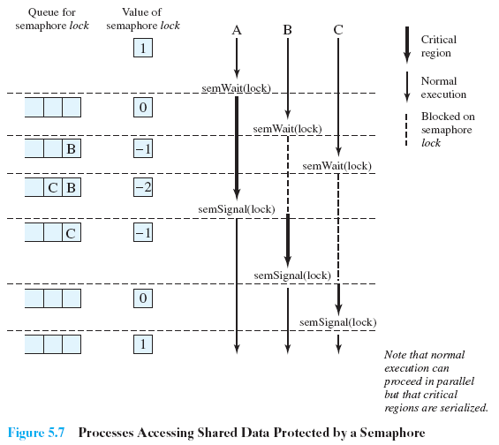

Slide 73
Deadlock and Starvation
Deadlock – two or more processes are waiting indefinitely for an event that can be caused by only one of the waiting processes
Let S and Q be two semaphores initialized to 1
P₀ P₁
wait (S); wait (Q);
wait (Q); wait (S);
. .
. .
. .
signal (S); signal (Q);
signal (Q); signal (S);
Starvation – indefinite blocking. A process may never be removed from the semaphore queue in which it is suspended

Slide 74
R1
R2
S
1
Q
1
I want to R1
I want to R2
P1
P2

Slide 75
R1
R2
S
1
Q
1
Wait(S)
Wait(Q)
P1
P2

Slide 76
R1
R2
S
0
Q
0
ACCESS R1
NOW, I want to R1
ACCESS R2
NOW I want to R2
P1
P2

Slide 77
R1
R2
S
0
Q
0
Wait(Q)
ACCESS R1
NOW, I want to R1
ACCESS R2
P1
P2

Slide 78
R1
R2
S
0
Q
0
BLOCKED
ACCESS R1
NOW, I want to R1
ACCESS R2
Ohh!! P2 is there
P1
P2

Slide 79
R1
R2
S
0
Q
0
BLOCKED
ACCESS R1
ACCESS R2
Ohh!! P2 is there
Wait(S)
P1
P2

Slide 80
R1
R2
S
0
Q
0
P1 BLOCKED
ACCESS R1
ACCESS R2
Ohh!! P2 is there
P2 BLOCKED
Ohh!! P1 is there
P1
P2

Slide 81
R1
R2
S
0
Q
0
P1 BLOCKED
ACCESS R1
ACCESS R2
Ohh!! P2 is there
P2 BLOCKED
Ohh!! P1 is there
P1
P2

Slide 82
DEADLOCK
P1
wait
R2
hold
hold
P2
R1
wait

Slide 83
STARVATION
P1
wait
R2
hold
hold
P2
R1
wait
Ohh!! I am waiting from so much time
P3

Slide 84
Classical Problems of Synchronization
Bounded-Buffer Problem
Readers and Writers Problem
Dining-Philosophers Problem

Slide 85
Bounded-Buffer Problem
It is also called Producer- Consumer problem
a multi-process synchronization problem
It illustrates the need for synchronization in systems where many processes share a resource.
In the problem, two processes share a fixed-size buffer.
Producer : Producer Process puts information in the buffer
Consumer : Consumer process takes information out of the buffer

Slide 86
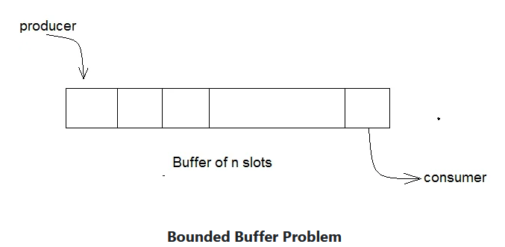
Bounded-Buffer Problem
PROBLEM : The problem is to make sure that
The producer won't try to add data into the buffer if it's full
The consumer won't try to remove data from an empty buffer
The producer and consumer should not insert data simultaneously (at the same time)

Slide 87
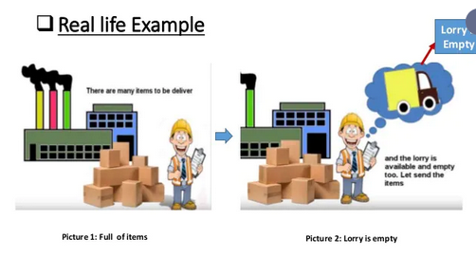

Slide 88
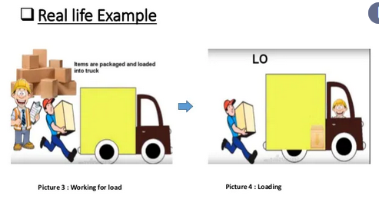

Slide 89
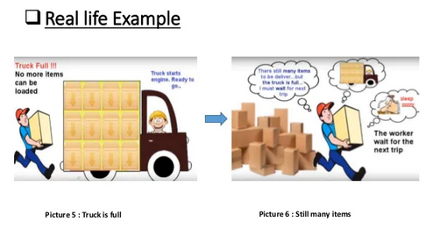

Slide 90
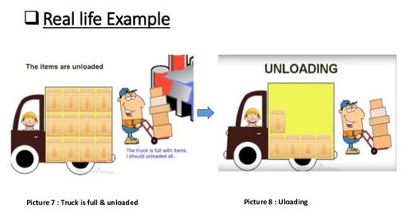

Slide 91
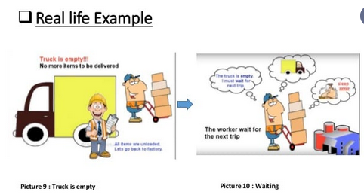

Slide 92
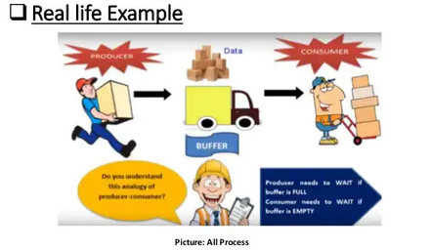

Slide 93
Bounded-Buffer Problem
One solution of this problem is to use semaphores.
The semaphores which will be used here are:
N buffers, each can hold one item
Semaphore mutex ( initialized to the value 1):a binary semaphore which is used to acquire and release the lock.
Semaphore full (initialized to the value 0: a counting semaphore whose initial value is the number of slots in the buffer, since, initially all slots are empty.
Semaphore empty (initialized to the value N):a counting semaphore whose initial value is 0.

Slide 94
Bounded Buffer Problem (Cont.)
The structure of the producer process
do {
// produce an item in nextp
wait (empty);
wait (mutex);
// add the item to the buffer
signal (mutex);
signal (full);
} while (TRUE);

Slide 95
Bounded Buffer Problem (Cont.)
The structure of the consumer process
do {
wait (full);
wait (mutex);
// remove an item from buffer to nextc
signal (mutex);
signal (empty);
// consume the item in nextc
} while (TRUE);

Slide 96
Bounded Buffer
do {
// produce an item in nextp
wait (empty);
wait (mutex);
// add the item to the buffer
signal (mutex);
signal (full);
} while (TRUE);
Mutex
1
Empty
3
0
FULL
PRODUCER
CONSUMER

Slide 97
Bounded Buffer
do {
// produce an item in nextp
wait (empty);
wait (mutex);
// add the item to the buffer
signal (mutex);
signal (full);
} while (TRUE);
Mutex
1
Empty
3
Wait(empty)
0
FULL
PRODUCER
CONSUMER

Slide 98
Bounded Buffer
do {
// produce an item in nextp
wait (empty);
wait (mutex);
// add the item to the buffer
signal (mutex);
signal (full);
} while (TRUE);
Mutex
1
Empty
2
Wait(mutex)
0
FULL
PRODUCER
CONSUMER

Slide 99
Bounded Buffer
do {
// produce an item in nextp
wait (empty);
wait (mutex);
// add the item to the buffer
signal (mutex);
signal (full);
} while (TRUE);
Item
Mutex
0
Empty
2
0
FULL
PRODUCER
CONSUMER

Slide 100
Bounded Buffer
do {
// produce an item in nextp
wait (empty);
wait (mutex);
// add the item to the buffer
signal (mutex);
signal (full);
} while (TRUE);
Item
Mutex
0
Empty
2
Signal (mutex)
0
FULL
PRODUCER
CONSUMER

Slide 101
Bounded Buffer
do {
// produce an item in nextp
wait (empty);
wait (mutex);
// add the item to the buffer
signal (mutex);
signal (full);
} while (TRUE);
Item
Mutex
1
Empty
2
Signal (FULL)
0
FULL
PRODUCER
CONSUMER

Slide 102
Bounded Buffer
do {
// produce an item in nextp
wait (empty);
wait (mutex);
// add the item to the buffer
signal (mutex);
signal (full);
} while (TRUE);
Item
Mutex
1
Empty
2
1
FULL
PRODUCER
CONSUMER

Slide 103
Bounded Buffer
do {
// produce an item in nextp
wait (empty);
wait (mutex);
// add the item to the buffer
signal (mutex);
signal (full);
} while (TRUE);
Item
Mutex
1
Empty
2
Wait(empty)
1
FULL
PRODUCER
CONSUMER

Slide 104
Bounded Buffer
do {
// produce an item in nextp
wait (empty);
wait (mutex);
// add the item to the buffer
signal (mutex);
signal (full);
} while (TRUE);
Item
Mutex
1
Empty
1
Wait(mutex)
1
FULL
PRODUCER
CONSUMER

Slide 105
Bounded Buffer
do {
// produce an item in nextp
wait (empty);
wait (mutex);
// add the item to the buffer
signal (mutex);
signal (full);
} while (TRUE);
Item | Item
Mutex
0
ADD
Empty
1
1
FULL
PRODUCER
CONSUMER

Slide 106
Bounded Buffer
do {
// produce an item in nextp
wait (empty);
wait (mutex);
// add the item to the buffer
signal (mutex);
signal (full);
} while (TRUE);
Item | Item
Mutex
0
Empty
1
Signal (mutex)
1
FULL
PRODUCER
CONSUMER

Slide 107
Bounded Buffer
do {
// produce an item in nextp
wait (empty);
wait (mutex);
// add the item to the buffer
signal (mutex);
signal (full);
} while (TRUE);
Item | Item
Mutex
1
Empty
1
Signal (FULL)
1
FULL
PRODUCER
CONSUMER

Slide 108
Bounded Buffer
do {
// produce an item in nextp
wait (empty);
wait (mutex);
// add the item to the buffer
signal (mutex);
signal (full);
} while (TRUE);
Item | Item
Mutex
1
Empty
1
2
FULL
PRODUCER
CONSUMER

Slide 109
Bounded Buffer
do {
wait (full);
wait (mutex);
// remove an item from buffer to nextc
signal (mutex);
signal (empty);
// consume the item in nextc
} while (TRUE);
Item | Item
Mutex
1
Empty
1
Wait(FULL)
2
FULL
CONSUMER
PRODUCER

Slide 110
Bounded Buffer
do {
wait (full);
wait (mutex);
// remove an item from buffer to nextc
signal (mutex);
signal (empty);
// consume the item in nextc
} while (TRUE);
Item | Item
Mutex
1
Wait(mutex)
Empty
1
1
FULL
CONSUMER
PRODUCER

Slide 111
Bounded Buffer
do {
wait (full);
wait (mutex);
// remove an item from buffer to nextc
signal (mutex);
signal (empty);
// consume the item in nextc
} while (TRUE);
Item | Item
Mutex
0
Remove ITEM
Empty
1
1
FULL
CONSUMER
PRODUCER

Slide 112
Bounded Buffer
do {
wait (full);
wait (mutex);
// remove an item from buffer to nextc
signal (mutex);
signal (empty);
// consume the item in nextc
} while (TRUE);
Item
Mutex
0
Signal (mutex)
Empty
1
1
FULL
CONSUMER
PRODUCER

Slide 113
Bounded Buffer
do {
wait (full);
wait (mutex);
// remove an item from buffer to nextc
signal (mutex);
signal (empty);
// consume the item in nextc
} while (TRUE);
Item
Mutex
1
Empty
1
Signal (empty)
1
FULL
CONSUMER
PRODUCER

Slide 114
Bounded Buffer
do {
wait (full);
wait (mutex);
// remove an item from buffer to nextc
signal (mutex);
signal (empty);
// consume the item in nextc
} while (TRUE);
Item
Mutex
1
Empty
2
1
FULL
CONSUMER
PRODUCER

Slide 115
Bounded Buffer
do {
// produce an item in nextp
wait (empty);
wait (mutex);
// add the item to the buffer
signal (mutex);
signal (full);
} while (TRUE);
Item
Mutex
1
Empty
2
Wait(empty)
1
FULL
PRODUCER
CONSUMER

Slide 116
Bounded Buffer
do {
// produce an item in nextp
wait (empty);
wait (mutex);
// add the item to the buffer
signal (mutex);
signal (full);
} while (TRUE);
Item
Mutex
1
Empty
1
Wait(mutex)
1
FULL
PRODUCER
CONSUMER

Slide 117
Bounded Buffer
do {
// produce an item in nextp
wait (empty);
wait (mutex);
// add the item to the buffer
signal (mutex);
signal (full);
} while (TRUE);
Item | Item
Mutex
0
ADD
Empty
1
1
FULL
PRODUCER
CONSUMER

Slide 118
Bounded Buffer
do {
// produce an item in nextp
wait (empty);
wait (mutex);
// add the item to the buffer
signal (mutex);
signal (full);
} while (TRUE);
Item | Item
Mutex
0
Empty
1
Signal (mutex)
1
FULL
PRODUCER
CONSUMER

Slide 119
Bounded Buffer
do {
// produce an item in nextp
wait (empty);
wait (mutex);
// add the item to the buffer
signal (mutex);
signal (full);
} while (TRUE);
Item | Item
Mutex
1
Empty
1
Signal (FULL)
1
FULL
PRODUCER
CONSUMER

Slide 120
Bounded Buffer
do {
// produce an item in nextp
wait (empty);
wait (mutex);
// add the item to the buffer
signal (mutex);
signal (full);
} while (TRUE);
Item | Item
Mutex
1
Empty
1
2
FULL
PRODUCER
CONSUMER

Slide 121
Bounded Buffer
do {
// produce an item in nextp
wait (empty);
wait (mutex);
// add the item to the buffer
signal (mutex);
signal (full);
} while (TRUE);
Item | Item
Mutex
1
Empty
1
Wait(empty)
2
FULL
PRODUCER
CONSUMER

Slide 122
Bounded Buffer
do {
// produce an item in nextp
wait (empty);
wait (mutex);
// add the item to the buffer
signal (mutex);
signal (full);
} while (TRUE);
Item | Item
Mutex
1
Empty
0
Wait(mutex)
2
FULL
PRODUCER
CONSUMER

Slide 123
Bounded Buffer
do {
// produce an item in nextp
wait (empty);
wait (mutex);
// add the item to the buffer
signal (mutex);
signal (full);
} while (TRUE);
Item | Item | Item
Mutex
0
ADD
Empty
0
2
FULL
PRODUCER
CONSUMER

Slide 124
Bounded Buffer
do {
// produce an item in nextp
wait (empty);
wait (mutex);
// add the item to the buffer
signal (mutex);
signal (full);
} while (TRUE);
Item | Item | Item
Mutex
0
Empty
0
Signal (mutex)
2
FULL
PRODUCER
CONSUMER

Slide 125
Bounded Buffer
do {
// produce an item in nextp
wait (empty);
wait (mutex);
// add the item to the buffer
signal (mutex);
signal (full);
} while (TRUE);
Item | Item | Item
Mutex
1
Empty
0
Signal (FULL)
2
FULL
PRODUCER
CONSUMER

Slide 126
Bounded Buffer
do {
// produce an item in nextp
wait (empty);
wait (mutex);
// add the item to the buffer
signal (mutex);
signal (full);
} while (TRUE);
Item | Item | Item
Mutex
1
Empty
0
3
FULL
PRODUCER
CONSUMER

Slide 127
Bounded Buffer
do {
// produce an item in nextp
wait (empty);
wait (mutex);
// add the item to the buffer
signal (mutex);
signal (full);
} while (TRUE);
Item | Item | Item
Mutex
1
Trying to produce item..But no slot empty (buffer full)
Empty
0
Wait(empty)
3
FULL
PRODUCER
CONSUMER

Slide 128
Bounded Buffer
do {
// produce an item in nextp
wait (empty);
wait (mutex);
// add the item to the buffer
signal (mutex);
signal (full);
} while (TRUE);
Item | Item | Item
Mutex
1
no slot empty (buffer full)
Waiting…
Empty
0
3
FULL
PRODUCER
CONSUMER

Slide 129
Bounded Buffer
do {
wait (full);
wait (mutex);
// remove an item from buffer to nextc
signal (mutex);
signal (empty);
// consume the item in nextc
} while (TRUE);
Item | Item | Item
Mutex
1
Empty
0
Wait(FULL)
3
FULL
CONSUMER
PRODUCER

Slide 130
Bounded Buffer
do {
wait (full);
wait (mutex);
// remove an item from buffer to nextc
signal (mutex);
signal (empty);
// consume the item in nextc
} while (TRUE);
Item | Item | Item
Mutex
1
Wait(mutex)
Empty
0
2
FULL
CONSUMER
PRODUCER

Slide 131
Bounded Buffer
do {
wait (full);
wait (mutex);
// remove an item from buffer to nextc
signal (mutex);
signal (empty);
// consume the item in nextc
} while (TRUE);
Item | Item | Item
Mutex
0
Remove ITEM
Empty
0
2
FULL
CONSUMER
PRODUCER

Slide 132
Bounded Buffer
do {
wait (full);
wait (mutex);
// remove an item from buffer to nextc
signal (mutex);
signal (empty);
// consume the item in nextc
} while (TRUE);
Item | Item
Mutex
0
Signal (mutex)
Empty
0
2
FULL
CONSUMER
PRODUCER

Slide 133
Bounded Buffer
do {
wait (full);
wait (mutex);
// remove an item from buffer to nextc
signal (mutex);
signal (empty);
// consume the item in nextc
} while (TRUE);
Item | Item
Mutex
1
Empty
0
Signal (empty)
2
FULL
CONSUMER
PRODUCER

Slide 134
Bounded Buffer
do {
wait (full);
wait (mutex);
// remove an item from buffer to nextc
signal (mutex);
signal (empty);
// consume the item in nextc
} while (TRUE);
Item | Item
Mutex
1
Empty
1
2
FULL
CONSUMER
PRODUCER

Slide 135
Bounded Buffer
do {
wait (full);
wait (mutex);
// remove an item from buffer to nextc
signal (mutex);
signal (empty);
// consume the item in nextc
} while (TRUE);
Item | Item
Mutex
1
Empty
1
Wait(FULL)
2
FULL
CONSUMER
PRODUCER

Slide 136
Bounded Buffer
do {
wait (full);
wait (mutex);
// remove an item from buffer to nextc
signal (mutex);
signal (empty);
// consume the item in nextc
} while (TRUE);
Item | Item
Mutex
1
Wait(mutex)
Empty
1
1
FULL
CONSUMER
PRODUCER

Slide 137
Bounded Buffer
do {
wait (full);
wait (mutex);
// remove an item from buffer to nextc
signal (mutex);
signal (empty);
// consume the item in nextc
} while (TRUE);
Item | Item
Mutex
0
Remove ITEM
Empty
1
1
FULL
CONSUMER
PRODUCER

Slide 138
Bounded Buffer
do {
wait (full);
wait (mutex);
// remove an item from buffer to nextc
signal (mutex);
signal (empty);
// consume the item in nextc
} while (TRUE);
Item
Mutex
0
Signal (mutex)
Empty
1
1
FULL
CONSUMER
PRODUCER

Slide 139
Bounded Buffer
do {
wait (full);
wait (mutex);
// remove an item from buffer to nextc
signal (mutex);
signal (empty);
// consume the item in nextc
} while (TRUE);
Item
Mutex
1
Empty
1
Signal (empty)
1
FULL
CONSUMER
PRODUCER

Slide 140
Bounded Buffer
do {
wait (full);
wait (mutex);
// remove an item from buffer to nextc
signal (mutex);
signal (empty);
// consume the item in nextc
} while (TRUE);
Item
Mutex
1
Empty
2
1
FULL
PRODUCER
CONSUMER

Slide 141
Bounded Buffer
do {
wait (full);
wait (mutex);
// remove an item from buffer to nextc
signal (mutex);
signal (empty);
// consume the item in nextc
} while (TRUE);
Item
Mutex
1
Empty
2
Wait(FULL)
1
FULL
CONSUMER
PRODUCER

Slide 142
Bounded Buffer
do {
wait (full);
wait (mutex);
// remove an item from buffer to nextc
signal (mutex);
signal (empty);
// consume the item in nextc
} while (TRUE);
Item
Mutex
1
Wait(mutex)
Empty
2
0
FULL
CONSUMER
PRODUCER

Slide 143
Bounded Buffer
do {
wait (full);
wait (mutex);
// remove an item from buffer to nextc
signal (mutex);
signal (empty);
// consume the item in nextc
} while (TRUE);
Item
Mutex
0
Remove ITEM
Empty
2
0
FULL
CONSUMER
PRODUCER

Slide 144
Bounded Buffer
do {
wait (full);
wait (mutex);
// remove an item from buffer to nextc
signal (mutex);
signal (empty);
// consume the item in nextc
} while (TRUE);
Mutex
0
Signal (mutex)
Empty
2
0
FULL
CONSUMER
PRODUCER

Slide 145
Bounded Buffer
do {
wait (full);
wait (mutex);
// remove an item from buffer to nextc
signal (mutex);
signal (empty);
// consume the item in nextc
} while (TRUE);
Mutex
1
Empty
2
Signal (empty)
0
FULL
CONSUMER
PRODUCER

Slide 146
Bounded Buffer
do {
wait (full);
wait (mutex);
// remove an item from buffer to nextc
signal (mutex);
signal (empty);
// consume the item in nextc
} while (TRUE);
Mutex
1
Empty
3
0
FULL
CONSUMER
PRODUCER

Slide 147
Bounded Buffer
do {
wait (full);
wait (mutex);
// remove an item from buffer to nextc
signal (mutex);
signal (empty);
// consume the item in nextc
} while (TRUE);
Trying to Consume item..But no item in buffer
Mutex
1
Empty
3
Wait(FULL)
0
FULL
CONSUMER
PRODUCER

Slide 148
Bounded Buffer
do {
wait (full);
wait (mutex);
// remove an item from buffer to nextc
signal (mutex);
signal (empty);
// consume the item in nextc
} while (TRUE);
Waiting ….as no item in buffer
Mutex
1
Empty
3
0
FULL
CONSUMER
PRODUCER

Slide 149
Readers-Writers Problem
A data set is shared among a number of concurrent processes.
Readers – only read the data set; they do not perform any updates
Writers – can both read and write
Problem – allow multiple readers to read at the same time. Only one single writer can access the shared data at the same time.

Slide 150
Readers-Writers Problem
Shared Data
Data set
Semaphore mutex initialized to 1 (controls access to readcount)
Semaphore wrt initialized to 1 (writer access)
Integer readcount initialized to 0 (how many processes are reading object)

Slide 151
Readers-Writers Problem (Cont.)
The structure of a writer process
do {
wait (wrt) ; //wrt.acquire(); in JAVA
// writing is performed
signal (wrt) ; //wrt.release(); in JAVA
} while (TRUE);

Slide 152
Readers-Writers Problem (Cont.)
The structure of a reader process
do {
wait (mutex) ; //mutex.acquire(); in JAVA
readcount ++ ;
if (readcount == 1)
wait (wrt) ; //wrt.acquire(); in JAVA
signal (mutex) //mutex.release(); in JAVA
// reading is performed
wait (mutex) ;
readcount - - ;
if (readcount == 0)
signal (wrt) ; //wrt.release(); in JAVA
signal (mutex) ;
} while (TRUE);

Slide 153
Dataset
Writer
do {
wait (wrt) ;
// writing is performed
signal (wrt) ;
} while (TRUE);
I want to write data
Mutex
1
Wrt
1
readcount
0
Writer
Reader-1

Slide 154
Dataset
Writer
do {
wait (wrt) ;
// writing is performed
signal (wrt) ;
} while (TRUE);
Mutex
1
Wrt
1
wait (wrt)
readcount
0
Writer
Reader-1

Slide 155
Dataset
Writer
do {
wait (wrt) ;
// writing is performed
signal (wrt) ;
} while (TRUE);
Mutex
Write Data
1
Wrt
0
readcount
0
Writer
Reader-1

Slide 156
Dataset
Writer
do {
wait (wrt) ;
// writing is performed
signal (wrt) ;
} while (TRUE);
DATA
Mutex
1
Wrt
0
Signal(wrt)
readcount
0
Writer
Reader-1

Slide 157
Dataset
Reader-1
do {
wait (mutex) ;
readcount ++ ;
if (readcount == 1)
wait (wrt) ;
signal (mutex)
// reading is performed
wait (mutex) ;
readcount - - ;
if (readcount == 0)
signal (wrt) ;
signal (mutex) ;
} while (TRUE);
DATA
I want to Read data
Mutex
1
Wrt
1
readcount
0
Writer
Reader-1

Slide 158
Dataset
Reader-1
do {
wait (mutex) ;
readcount ++ ;
if (readcount == 1)
wait (wrt) ;
signal (mutex)
// reading is performed
wait (mutex) ;
readcount - - ;
if (readcount == 0)
signal (wrt) ;
signal (mutex) ;
} while (TRUE);
DATA
I want to Read data
Mutex
1
Wrt
1
readcount
0
Writer
Reader-1

Slide 159
Dataset
Reader-1
do {
wait (mutex) ;
readcount ++ ;
if (readcount == 1)
wait (wrt) ;
signal (mutex)
// reading is performed
wait (mutex) ;
readcount - - ;
if (readcount == 0)
signal (wrt) ;
signal (mutex) ;
} while (TRUE);
DATA
Mutex
1
Wrt
1
wait(mutex)
readcount
0
Writer
Reader-1

Slide 160
Dataset
Reader-1
do {
wait (mutex) ;
readcount ++ ;
if (readcount == 1)
wait (wrt) ;
signal (mutex)
// reading is performed
wait (mutex) ;
readcount - - ;
if (readcount == 0)
signal (wrt) ;
signal (mutex) ;
} while (TRUE);
DATA
Mutex
0
Wrt
1
readcount++
readcount
0
Writer
Reader-1

Slide 161
Dataset
Reader-1
do {
wait (mutex) ;
readcount ++ ;
if (readcount == 1)
wait (wrt) ;
signal (mutex)
// reading is performed
wait (mutex) ;
readcount - - ;
if (readcount == 0)
signal (wrt) ;
signal (mutex) ;
} while (TRUE);
DATA
Mutex
0
Wrt
1
If(readcount==1)?
readcount
1
Writer
Reader-1

Slide 162
Dataset
Reader-1
do {
wait (mutex) ;
readcount ++ ;
if (readcount == 1)
wait (wrt) ;
signal (mutex)
// reading is performed
wait (mutex) ;
readcount - - ;
if (readcount == 0)
signal (wrt) ;
signal (mutex) ;
} while (TRUE);
DATA
Mutex
0
Wrt
1
Wait(wrt)
readcount
1
Writer
Reader-1

Slide 163
Dataset
Reader-1
do {
wait (mutex) ;
readcount ++ ;
if (readcount == 1)
wait (wrt) ;
signal (mutex)
// reading is performed
wait (mutex) ;
readcount - - ;
if (readcount == 0)
signal (wrt) ;
signal (mutex) ;
} while (TRUE);
DATA
Mutex
0
Wrt
0
Signal(mutex)
readcount
1
Writer
Reader-1

Slide 164
Dataset
Reader-1
do {
wait (mutex) ;
readcount ++ ;
if (readcount == 1)
wait (wrt) ;
signal (mutex)
// reading is performed
wait (mutex) ;
readcount - - ;
if (readcount == 0)
signal (wrt) ;
signal (mutex) ;
} while (TRUE);
DATA
Mutex
1
Wrt
Reading data
0
readcount
1
Writer
Reader-1

Slide 165
Dataset
Reader-2
do {
wait (mutex) ;
readcount ++ ;
if (readcount == 1)
wait (wrt) ;
signal (mutex)
// reading is performed
wait (mutex) ;
readcount - - ;
if (readcount == 0)
signal (wrt) ;
signal (mutex) ;
} while (TRUE);
DATA
Mutex
1
Wrt
Reading data
0
I want to Read data
readcount
1
Writer
Reader-2
Reader-1

Slide 166
Dataset
Reader-2
do {
wait (mutex) ;
readcount ++ ;
if (readcount == 1)
wait (wrt) ;
signal (mutex)
// reading is performed
wait (mutex) ;
readcount - - ;
if (readcount == 0)
signal (wrt) ;
signal (mutex) ;
} while (TRUE);
DATA
Mutex
1
Wrt
Reading data
0
Wait(mutex)
readcount
1
Writer
Reader-2
Reader-1

Slide 167
Dataset
Reader-2
do {
wait (mutex) ;
readcount ++ ;
if (readcount == 1)
wait (wrt) ;
signal (mutex)
// reading is performed
wait (mutex) ;
readcount - - ;
if (readcount == 0)
signal (wrt) ;
signal (mutex) ;
} while (TRUE);
DATA
Mutex
0
Wrt
Reading data
0
readcount++
readcount
1
Writer
Reader-2
Reader-1

Slide 168
Dataset
Reader-2
do {
wait (mutex) ;
readcount ++ ;
if (readcount == 1)
wait (wrt) ;
signal (mutex)
// reading is performed
wait (mutex) ;
readcount - - ;
if (readcount == 0)
signal (wrt) ;
signal (mutex) ;
} while (TRUE);
DATA
Mutex
0
Wrt
Reading data
0
If(readcount==1)?
readcount
2
Writer
Reader-2
Reader-1

Slide 169
Dataset
Reader-2
do {
wait (mutex) ;
readcount ++ ;
if (readcount == 1)
wait (wrt) ;
signal (mutex)
// reading is performed
wait (mutex) ;
readcount - - ;
if (readcount == 0)
signal (wrt) ;
signal (mutex) ;
} while (TRUE);
DATA
Mutex
0
Wrt
Reading data
0
Signal Mutex)
readcount
2
Writer
Reader-2
Reader-1

Slide 170
Dataset
Reader-2
do {
wait (mutex) ;
readcount ++ ;
if (readcount == 1)
wait (wrt) ;
signal (mutex)
// reading is performed
wait (mutex) ;
readcount - - ;
if (readcount == 0)
signal (wrt) ;
signal (mutex) ;
} while (TRUE);
DATA
Mutex
1
Wrt
0
Reading data
Reading data
readcount
2
Writer
Reader-2
Reader-1

Slide 171
Dataset
Writer
do {
wait (wrt) ;
// writing is performed
signal (wrt) ;
} while (TRUE);
DATA
I want to write data
Mutex
1
Wrt
0
Reading data
Reading data
readcount
2
Writer
Reader-2
Reader-1

Slide 172
Dataset
Writer
do {
wait (wrt) ;
// writing is performed
signal (wrt) ;
} while (TRUE);
DATA
Mutex
1
Wrt
0
Reading data
Reading data
readcount
2
Wait(wrt)
Writer
Reader-2
Reader-1

Slide 173
Dataset
Writer
do {
wait (wrt) ;
// writing is performed
signal (wrt) ;
} while (TRUE);
DATA
Mutex
1
Waiting...as wrt=0 means Readers are reading
Wrt
0
Reading data
Reading data
readcount
2
Writer
Reader-2
Reader-1

Slide 174
Dataset
Reader-1
do {
wait (mutex) ;
readcount ++ ;
if (readcount == 1)
wait (wrt) ;
signal (mutex)
// reading is performed
wait (mutex) ;
readcount - - ;
if (readcount == 0)
signal (wrt) ;
signal (mutex) ;
} while (TRUE);
DATA
Mutex
1
Reading done
Wrt
0
Reading data
Reading data
readcount
2
Writer
Reader-2
Reader-1

Slide 175
Dataset
Reader-1
do {
wait (mutex) ;
readcount ++ ;
if (readcount == 1)
wait (wrt) ;
signal (mutex)
// reading is performed
wait (mutex) ;
readcount - - ;
if (readcount == 0)
signal (wrt) ;
signal (mutex) ;
} while (TRUE);
DATA
Mutex
1
Wrt
0
Reading data
Wait(mutex)
readcount
2
Writer
Reader-2
Reader-1

Slide 176
Dataset
Reader-1
do {
wait (mutex) ;
readcount ++ ;
if (readcount == 1)
wait (wrt) ;
signal (mutex)
// reading is performed
wait (mutex) ;
readcount - - ;
if (readcount == 0)
signal (wrt) ;
signal (mutex) ;
} while (TRUE);
DATA
Mutex
0
Wrt
0
Reading data
readcount
2
readcount--
Writer
Reader-2
Reader-1

Slide 177
Dataset
Reader-1
do {
wait (mutex) ;
readcount ++ ;
if (readcount == 1)
wait (wrt) ;
signal (mutex)
// reading is performed
wait (mutex) ;
readcount - - ;
if (readcount == 0)
signal (wrt) ;
signal (mutex) ;
} while (TRUE);
DATA
Mutex
0
Wrt
0
Reading data
readcount
1
Is (readcount==0)?
Writer
Reader-2
Reader-1

Slide 178
Dataset
Reader-1
do {
wait (mutex) ;
readcount ++ ;
if (readcount == 1)
wait (wrt) ;
signal (mutex)
// reading is performed
wait (mutex) ;
readcount - - ;
if (readcount == 0)
signal (wrt) ;
signal (mutex) ;
} while (TRUE);
DATA
Mutex
0
Wrt
0
Reading data
Signal(mutex)
readcount
1
Writer
Reader-2
Reader-1

Slide 179
Dataset
Reader-1
do {
wait (mutex) ;
readcount ++ ;
if (readcount == 1)
wait (wrt) ;
signal (mutex)
// reading is performed
wait (mutex) ;
readcount - - ;
if (readcount == 0)
signal (wrt) ;
signal (mutex) ;
} while (TRUE);
DATA
Mutex
1
Wrt
0
Reading data
readcount
1
Writer
Reader-2
Reader-1

Slide 180
Dataset
Reader-2
do {
wait (mutex) ;
readcount ++ ;
if (readcount == 1)
wait (wrt) ;
signal (mutex)
// reading is performed
wait (mutex) ;
readcount - - ;
if (readcount == 0)
signal (wrt) ;
signal (mutex) ;
} while (TRUE);
DATA
Mutex
1
Wrt
Reading done
0
Reading data
readcount
1
Writer
Reader-2
Reader-1

Slide 181
Dataset
Reader-2
do {
wait (mutex) ;
readcount ++ ;
if (readcount == 1)
wait (wrt) ;
signal (mutex)
// reading is performed
wait (mutex) ;
readcount - - ;
if (readcount == 0)
signal (wrt) ;
signal (mutex) ;
} while (TRUE);
DATA
Mutex
1
Wrt
0
Wait(mutex)
readcount
1
Writer
Reader-2
Reader-1

Slide 182
Dataset
Reader-2
do {
wait (mutex) ;
readcount ++ ;
if (readcount == 1)
wait (wrt) ;
signal (mutex)
// reading is performed
wait (mutex) ;
readcount - - ;
if (readcount == 0)
signal (wrt) ;
signal (mutex) ;
} while (TRUE);
DATA
Mutex
0
Wrt
0
readcount--
readcount
1
Writer
Reader-2
Reader-1

Slide 183
Dataset
Reader-2
do {
wait (mutex) ;
readcount ++ ;
if (readcount == 1)
wait (wrt) ;
signal (mutex)
// reading is performed
wait (mutex) ;
readcount - - ;
if (readcount == 0)
signal (wrt) ;
signal (mutex) ;
} while (TRUE);
DATA
Mutex
0
Wrt
0
Is (readcount==0)?
readcount
0
Writer
Reader-2
Reader-1

Slide 184
Dataset
Reader-2
do {
wait (mutex) ;
readcount ++ ;
if (readcount == 1)
wait (wrt) ;
signal (mutex)
// reading is performed
wait (mutex) ;
readcount - - ;
if (readcount == 0)
signal (wrt) ;
signal (mutex) ;
} while (TRUE);
DATA
Mutex
0
Wrt
0
signal(wrt)
readcount
0
Writer
Reader-2
Reader-1

Slide 185
Dataset
Reader-2
do {
wait (mutex) ;
readcount ++ ;
if (readcount == 1)
wait (wrt) ;
signal (mutex)
// reading is performed
wait (mutex) ;
readcount - - ;
if (readcount == 0)
signal (wrt) ;
signal (mutex) ;
} while (TRUE);
DATA
Mutex
0
Wrt
1
Signal(mutex)
readcount
0
Writer
Reader-2
Reader-1

Slide 186
Dataset
Reader-2
do {
wait (mutex) ;
readcount ++ ;
if (readcount == 1)
wait (wrt) ;
signal (mutex)
// reading is performed
wait (mutex) ;
readcount - - ;
if (readcount == 0)
signal (wrt) ;
signal (mutex) ;
} while (TRUE);
DATA
Mutex
1
Wrt
1
readcount
0
Writer
Reader-2
Reader-1

Slide 187
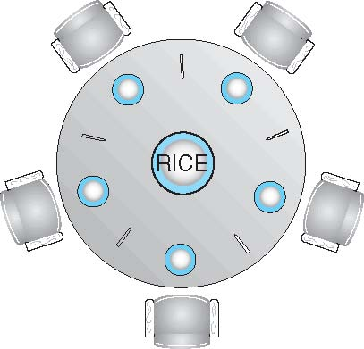
Dining-Philosophers Problem
Shared data
Bowl of rice (data set)
Semaphore chopstick [5] initialized to 1

Slide 188
Dining-Philosophers Problem (Cont.)
The structure of Philosopher i:
do {
wait ( chopstick[i] );
wait ( chopStick[ (i + 1) % 5] );
// eat
signal ( chopstick[i] );
signal (chopstick[ (i + 1) % 5] );
// think
} while (TRUE);
What is the problem with the above?

Slide 189
Monitors
Monitor is a highly structured programming- language construct.
It consists of
Private variables and private procedures that can only be used within a monitor.
Constructors that initialize the monitor.
A number of (public) monitor procedures that can be invoked by users.
Note that monitors have no public data.
A monitor is a mini-OS with monitor procedures as system calls.

Slide 190
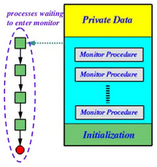
Monitors
Monitor

Slide 191
Monitors Example
P1
A
Get_a()
B
Put_a()
P2
Monitor

Slide 192
Monitors
A high-level abstraction that provides a convenient and effective mechanism for process synchronization
Only one process may be active within the monitor at a time
monitor monitor-name
{
// shared variable declarations
procedure P1 (…) { …. }
…
procedure Pn (…) {……}
Initialization code ( ….) { … }
…
}
}

Slide 193
Monitor Characteristics
Local data variables are accessible only by the monitor’s procedures and not by any external procedure
Process enters monitor by invoking one of its procedures
Only one process may be executing in the monitor at a time
Notes:
The chief characteristics of a monitor are the following:
1. The local data variables are accessible only by the monitor’s procedures and
not by any external procedure.
2. A process enters the monitor by invoking one of its procedures.
3. Only one process may be executing in the monitor at a time; any other processes
that have invoked the monitor are blocked, waiting for the monitor to become available.
The first two characteristics are reminiscent of those for objects in object-oriented software. Indeed, an object-oriented OS or programming language can readily implement a monitor as an object with special characteristics.
By enforcing the discipline of one process at a time, the monitor is able to provide a mutual exclusion facility. The data variables in the monitor can be accessed by only one process at a time. Thus, a shared data structure can be protected by placing it in a monitor. If the data in a monitor represent some resource, then the monitor provides a mutual exclusion facility for accessing the resource.
To be useful for concurrent processing, the monitor must include synchronization tools. For example, suppose a process invokes the monitor and, while in the
monitor, must be blocked until some condition is satisfied. A facility is needed by which the process is not only blocked but releases the monitor so that some other process may enter it. Later, when the condition is satisfied and the monitor is again available, the process needs to be resumed and allowed to reenter the monitor at the point of its suspension.

Slide 194
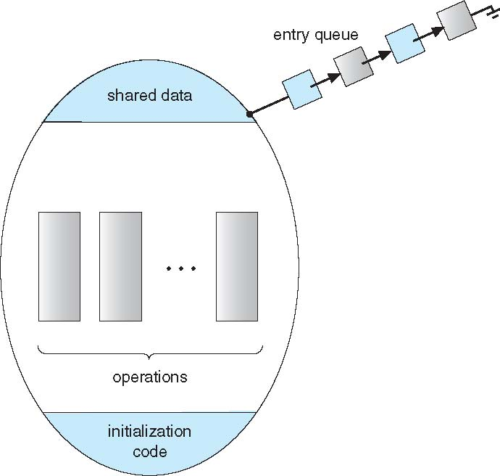
Schematic view of a Monitor

Slide 195
Condition Variables
While the process is executing within a monitor, a programmer may want to block this process and force it to wait until an event occurs.
Thus, each programmer-defined event is artificially associated with a condition variable.
condition x, y;
Two operations on a condition variable:
x.wait () – a process that invokes the operation is
suspended.
x.signal () – resumes one of processes (if any) that invoked x.wait ()

Slide 196
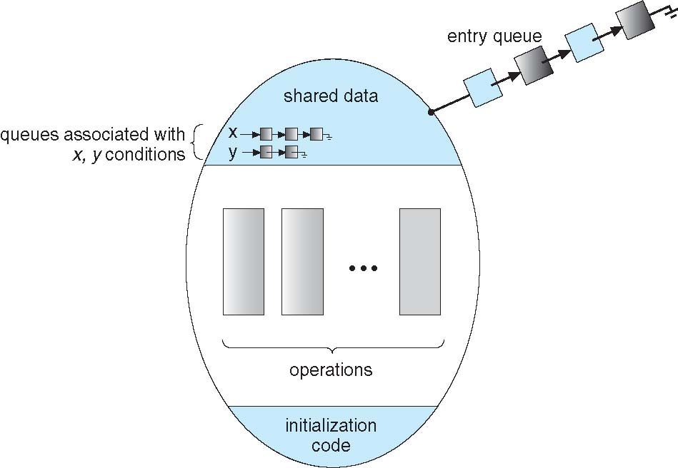
Monitor with Condition Variables

Slide 197
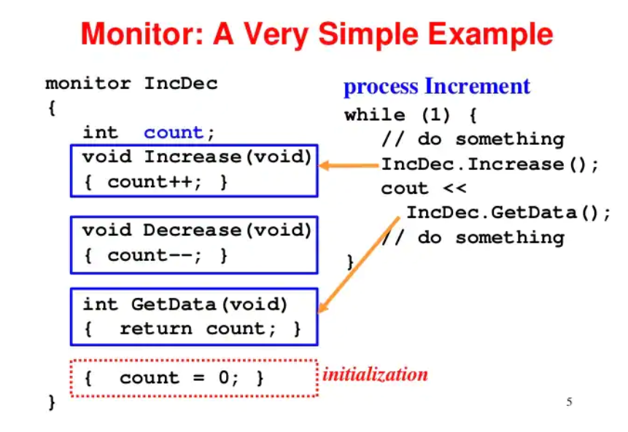

Slide 198
Solution to Dining Philosophers
monitor DP
{
enum { THINKING; HUNGRY, EATING) state [5] ;
condition self [5];
void pickup (int i) {
state[i] = HUNGRY;
test(i);
if (state[i] != EATING) self [i].wait;
}
void putdown (int i) {
state[i] = THINKING;
// test left and right neighbors
test((i + 4) % 5);
test((i + 1) % 5);
}

Slide 199
Solution to Dining Philosophers (Cont.)
void test (int i) {
if ( (state[(i + 4) % 5] != EATING) &&
(state[i] == HUNGRY) &&
(state[(i + 1) % 5] != EATING) ) {
state[i] = EATING ;
self[i].signal () ;
}
}
initialization_code() {
for (int i = 0; i < 5; i++)
state[i] = THINKING;
}
}

Slide 200
Solution to Dining Philosophers (Cont.)
Each philosopher I invokes the operations pickup()
and putdown() in the following sequence:
DiningPhilosophters.pickup (i);
EAT
DiningPhilosophers.putdown (i);

Slide 201
Initialization
State[P0]=Thinking
State[P1]=Thinking
State[P2]=Thinking
State[P3]=Thinking
State[P4]=Thinking
P1
P0
P2
P4
P3

Slide 202
P0
DiningPhilosophers.pickup (0);
I want to eat
Thinking
P1
P0
C2
Thinking
C3
C1
Thinking
P2
P4
C4
C5
Thinking
P3
Thinking

Slide 203
P0
void pickup (int i) {
state[i] = HUNGRY;
test(i);
if (state[i] != EATING) self [i].wait;
}
Thinking
P1
P0
Thinking
Hungry
C2
C3
C1
Thinking
P2
C4
P4
C5
Thinking
P3
Thinking

Slide 204
void test (int i)
{
if ( (state[(i + 4) % 5] != EATING) &&
(state[i] == HUNGRY) &&
(state[(i + 1) % 5] != EATING) )
{
state[i] = EATING ;
self[i].signal () ;
}
}
P0
Thinking
state[(0+ 4) % 5] != EATING) &&
(state[0] == HUNGRY) &&
(state[(0+ 1) % 5] != EATING)
P1
P0
Hungry
C2
state[4] != EATING) &&
(state[0] == HUNGRY) &&
(state[1] != EATING)
C3
C1
Thinking
P2
C4
P4
C5
Thinking
P3
Thinking

Slide 205
void test (int i) {
if ( (state[(i + 4) % 5] != EATING) &&
(state[i] == HUNGRY) &&
(state[(i + 1) % 5] != EATING) )
{
state[i] = EATING ;
self[i].signal () ;
}
}
P0
Thinking
P4 and P1 not eating, So I can eat
P1
P0
Eating
C2
C3
C1
Thinking
P2
C4
P4
C5
Thinking
P3
Thinking

Slide 206
P4
DiningPhilosophers.pickup (4);
Thinking
P1
P0
Eating
C2
I want to eat
C3
C1
Thinking
P2
P4
C4
C5
Thinking
P3
Thinking

Slide 207
P4
void pickup (int i) {
state[i] = HUNGRY;
test(i);
if (state[i] != EATING) self [i].wait;
}
Thinking
P1
P0
Eating
C2
C3
C1
Thinking
Hungry
Thinking
P2
C4
P4
C5
P3
Thinking

Slide 208
void test (int i)
{
if ( (state[(i + 4) % 5] != EATING) &&
(state[i] == HUNGRY) &&
(state[(i + 1) % 5] != EATING) )
{
state[i] = EATING ;
self[i].signal () ;
}
}
P4
Thinking
state[(4+ 4) % 5] != EATING) &&
(state[4] == HUNGRY) &&
(state[(0+ 1) % 5] != EATING)
P1
P0
Eating
C2
state[3] != EATING) &&
(state[4] == HUNGRY) &&
(state[0] != EATING)
C3
C1
I cannot eat bcoz P0 eating ..so wait
P2
C4
P4
Thinking
C5
Hungry
void pickup (int i) {
state[i] = HUNGRY;
test(i);
if (state[i] != EATING) self [i].wait;
}
P3
Thinking

Slide 209
P0
DiningPhilosophers.putdown (0);
My eating done
Thinking
P1
P0
Eating
C2
C3
C1
Thinking
P2
Hungry
C4
P4
C5
P3
Thinking

Slide 210
P0
void putdown (int i)
{
state[i] = THINKING;
// test left and right neighbors
test((i + 4) % 5);
test((i + 1) % 5);
}
Thinking
P1
P0
Eating
Thinking
C2
C3
C1
Thinking
Hungry
P2
C4
P4
C5
P3
Thinking

Slide 211
P0
void putdown (int i)
{
state[i] = THINKING;
// test left and right neighbors
test((i + 4) % 5);
test((i + 1) % 5);
}
Thinking
P1
P0
Thinking
test((0 + 4) % 5);
C2
test(4);
C3
C1
Thinking
Hungry
P2
C4
P4
C5
P3
Thinking

Slide 212
void test (int i)
{
if ( (state[(i + 4) % 5] != EATING) &&
(state[i] == HUNGRY) &&
(state[(i + 1) % 5] != EATING) )
{
state[i] = EATING ;
self[i].signal () ;
}
}
P4
Thinking
Thinking
state[(4+ 4) % 5] != EATING) &&
(state[4] == HUNGRY) &&
(state[(0+ 1) % 5] != EATING)
P1
P0
C2
state[3] != EATING) &&
(state[4] == HUNGRY) &&
(state[0] != EATING)
C3
C1
P2
C4
P4
I can eat now
Thinking
C5
Hungry
P3
Thinking

Slide 213

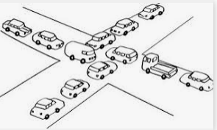

Slide 214
Resources
Resource: something a process uses
Usually limited (at least somewhat)
Examples of computer resources
Printers
Semaphores / locks
Tables (in a database)
Processes need access to resources in reasonable order
Two types of resources:
Preemptable resources: can be taken away from a process with no ill effects
Nonpreemptable resources: will cause the process to fail if taken away

Slide 215
Deadlocks
Formal definition : A set of processes is deadlocked if each process in the set is waiting for an event that only another process in the set can cause
Usually the event is release of a currently held resource
None of the processes can …
run
release resources
be awakened

Slide 216
When do deadlocks happen?
Suppose
Process 1 holds resource A and requests resource B
Process 2 holds B and requests A
Both can be blocked, with neither able to proceed
Deadlocks occur when …
Processes are granted exclusive access to devices or software constructs (resources)
Each deadlocked process needs a resource held by another deadlocked process
Process 1
Process 2
A
B
A
B
DEADLOCK!

Slide 217
Using resources
Sequence of events required to use a resource
Request the resource
Use the resource
Release the resource
Can’t use the resource if request is denied
Requesting process has options
Block and wait for resource
Continue (if possible) without it: may be able to use an alternate resource
Process fails with error code
Some of these may be able to prevent deadlock…

Slide 218
Four conditions for deadlock
Mutual exclusion
Each resource is assigned to at most one process
Hold and wait
A process holding resources can request more resources
No preemption
Previously granted resources cannot be forcibly taken away
Circular wait
There must be a circular chain of 2 or more processes where each is waiting for a resource held by the next member of the chain

Slide 219
Resource-Allocation Graph
Process
Resource Type with 4 instances
P_{i} requests instance of R_{j}
P_{i} is holding an instance of R_{j}
P_{i}
R_{j}
P_{i}
R_{j}

Slide 220
Resource allocation graphs
Resource allocation modeled by directed graphs
Example 1:
Resource R assigned to process A
Example 2:
Process B is requesting / waiting for resource S
Example 3:
Process C holds T, waiting for U
Process D holds U, waiting for T
C and D are in deadlock!
A
B
R
S
T
C
D
U

Slide 221
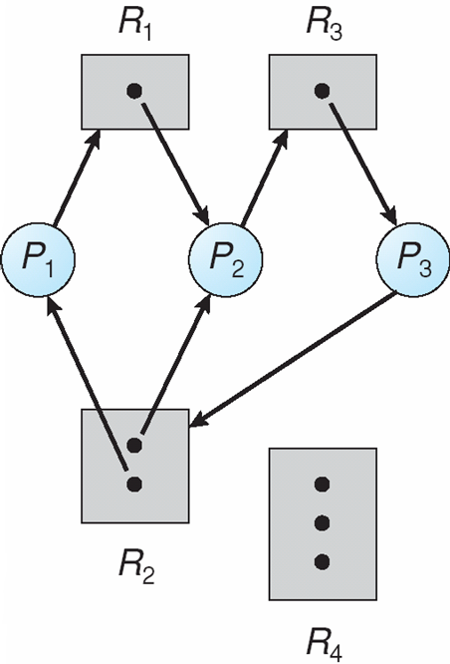
Resource Allocation Graph: Multiple Resources

Slide 222
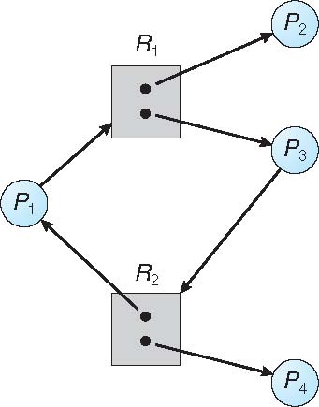
Graph With A Cycle But No Deadlock

Slide 223
If graph contains no cycles ⇒ no deadlock
If graph contains a cycle ⇒
if only one instance per resource type, then deadlock
necessary and sufficient condition
if several instances per resource type, possibility of deadlock
necessary condition

Slide 224
Dealing with deadlock
How can the OS deal with deadlock?
Ignore the problem altogether!
Hopefully, it’ll never happen…
Detect deadlock & recover from it
Prevent deadlock
Remove at least one of the four necessary conditions
Dynamically avoid deadlock
Careful resource allocation

Slide 225
Getting into deadlock
A
B
C
Acquire R
Acquire S
Release R
Release S
Acquire S
Acquire T
Release S
Release T
Acquire T
Acquire R
Release T
Release R
A
B
C
A
B
C
A
B
C
R
S
T
R
S
T
R
S
T
Acquire R
Acquire S
Acquire T
A
B
C
A
B
C
A
B
C
R
S
T
R
S
T
R
S
T
Deadlock!
Acquire S
Acquire T
Acquire R

Slide 226
Not getting into deadlock…
Many situations may result in deadlock (but don’t have to)
In previous example, A could release R before C requests R, resulting in no deadlock
Can we always get out of it this way?
Find ways to:
Detect deadlock and reverse it
Stop it from happening in the first place

Slide 227
1. The Ostrich Algorithm
Ignore the problem altogether!
Pretend there’s no problem
Reasonable if
Deadlocks occur very rarely
Cost of prevention is high
UNIX and Windows take this approach
Resources (memory, CPU, disk space) are plentiful
Deadlocks over such resources rarely occur
Deadlocks typically handled by rebooting
Trade off between convenience and correctness

Slide 228
2. Deadlock Detection and Removal
Allow system to enter deadlock state
Detection algorithm
Recovery scheme

Slide 229
Deadlock Detection using Resource allocation Graph
Process holdings and requests in the table and in the graph (they’re equivalent)
Graph contains a cycle => deadlock!
Easy to pick out by looking at it (in this case)
Need to mechanically detect deadlock
Not all processes are deadlocked (A, C, F not in deadlock)
R
A
B
Process | Holds | Wants
A | R | S
B |  | T
C |  | S
D | U | S,T
E | T | V
F | W | S
G | V | U
C
S
D
T
E
F
U
V
W
G

Slide 230
Detection-Algorithm Usage
When, and how often, to invoke depends on:
How often a deadlock is likely to occur?
How many processes will need to be rolled back?
one for each disjoint cycle
If detection algorithm is invoked arbitrarily, there may be many cycles in the resource graph and so we would not be able to tell which of the many deadlocked processes “caused” the deadlock.

Slide 231
Recovering from deadlock: options
Recovery through resource preemption
Take a resource from some other process
Depends on nature of the resource and the process
Recovery through rollback
Checkpoint a process periodically
Use this saved state to restart the process if it is found deadlocked
May present a problem if the process affects lots of “external” things
Recovery through killing processes
Crudest but simplest way to break a deadlock: kill one of the processes in the deadlock cycle
Other processes can get its resources
Preferably, choose a process that can be rerun from the beginning
Pick one that hasn’t run too far already

Slide 232
Deadlock Recovery: Process Termination
Abort all deadlocked processes
Abort one process at a time until the deadlock cycle is eliminated
In which order should we choose to abort?
Priority of the process
How long process has computed, and how much longer to completion
Resources the process has used
Resources process needs to complete
How many processes will need to be terminated
Is process interactive or batch?

Slide 233
Deadlock Prevention
Deadlock can be completely prevented!
Ensure that at least one of the conditions for deadlock never occurs
Mutual exclusion
Circular wait
Hold & wait
No preemption
Not always possible…

Slide 234
1. Eliminating mutual exclusion
Deadlock Prevention (Cont.)
Some devices (such as printer) can be spooled
Only the printer daemon uses printer resource
This eliminates deadlock for printer
Not all devices can be spooled
Principle:
Avoid assigning resource when not absolutely necessary
As few processes as possible actually claim the resource

Slide 235
2. Attacking “hold and wait”
Deadlock Prevention (Cont.)
Require processes to request resources before starting
A process never has to wait for what it needs
This can present problems
A process may not know required resources at start of run
This also ties up resources other processes could be using
Processes will tend to be conservative and request resources they might need
Variation: a process must give up all resources before making a new request
Process is then granted all prior resources as well as the new ones
Problem: what if someone grabs the resources in the meantime—how can the process save its state?

Slide 236
3. Attacking “no preemption”
Deadlock Prevention (Cont.)
This is not usually a viable option
Consider a process given the printer
Halfway through its job, take away the printer
Confusion ensues!
May work for some resources
Forcibly take away memory pages, suspending the process
Process may be able to resume with no ill effects

Slide 237
4. Attacking “circular wait”
Deadlock Prevention (Cont.)
Assign an order to resources
Always acquire resources in numerical order
Need not acquire them all at once!
Circular wait is prevented
A process holding resource n can’t wait for resource m if m < n
No way to complete a cycle
Place processes above the highest resource they hold and below any they’re requesting
All arrows point up!
D
C
3
2
B
1
A

Slide 238
Deadlock Prevention (Cont.)
No Preemption –
If a process that is holding some resources requests another resource that cannot be immediately allocated to it, then all resources currently being held are released
Preempted resources are added to the list of resources for which the process is waiting
Process will be restarted only when it can regain its old resources, as well as the new ones that it is requesting
Circular Wait – impose a total ordering of all resource types, and require that each process requests resources in an increasing order of enumeration

Slide 239
Deadlock Avoidance
Requires that the system has some additional a priori information available
Simplest and most useful model requires that each process declare the maximum number of resources of each type that it may need
The deadlock-avoidance algorithm dynamically examines the resource-allocation state to ensure that there can never be a circular-wait condition
Resource-allocation state is defined by the number of available and allocated resources, and the maximum demands of the processes

Slide 240
Safe State
When a process requests an available resource, system must decide if immediate allocation leaves the system in a safe state
System is in safe state if there exists a sequence <P₁, P₂, …, P_{n}> of ALL the processes is the systems such that for each P_{i}, the resources that P_{i} can still request can be satisfied by currently available resources + resources held by all the P_{j}, with j < I
That is:
If P_{i} resource needs are not immediately available, then P_{i} can wait until all P_{j} have finished
When P_{j} is finished, P_{i} can obtain needed resources, execute, return allocated resources, and terminate
When P_{i} terminates, P_{i +1} can obtain its needed resources, and so on

Slide 241
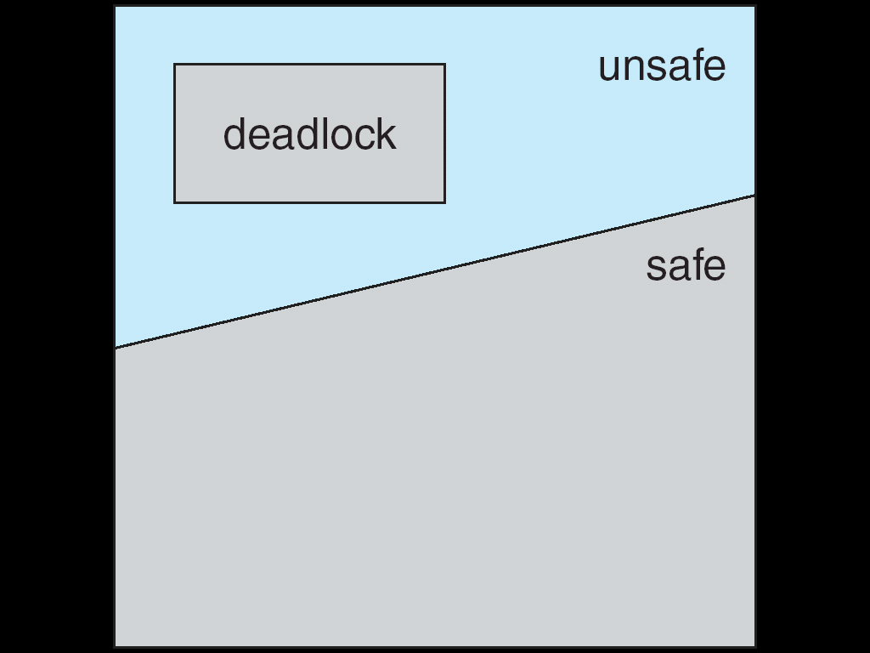
Safe, Unsafe, Deadlock State

Slide 242
Avoidance algorithms
Single instance of a resource type
Use a resource-allocation graph
Multiple instances of a resource type
Use the banker’s algorithm

Slide 243
1. Resource-Allocation Graph Scheme
Claim edge P_{i} → R_{j} indicated that process P_{j} may request resource R_{j}; represented by a dashed line
Claim edge converts to request edge when a process requests a resource
Request edge converted to an assignment edge when the resource is allocated to the process
When a resource is released by a process, assignment edge reconverts to a claim edge
Resources must be claimed a priori in the system

Slide 244
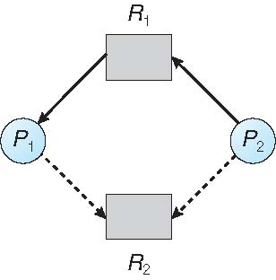
Resource-Allocation Graph

Slide 245
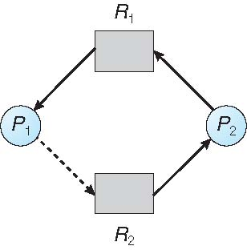
Unsafe State In Resource-Allocation Graph

Slide 246
Resource-Allocation Graph Algorithm
Suppose process P_{i} requests a resource R_{j}
The request can be granted only if converting the request edge to an assignment edge does not result in the formation of a cycle in the resource allocation graph

Slide 247
2. Banker’s Algorithm
Multiple instances
Each process must a priori claim maximum use
When a process requests a resource it may have to wait
When a process gets all its resources it must return them in a finite amount of time

Slide 248
Data Structures for the Banker’s Algorithm
2. Banker’s Algorithm (Cont..)
Let n = number of processes, and m = number of resources types.
Available: Vector of length m. If available [j] = k, there are k instances of resource type R_{j} available
Max: n x m matrix. If Max [i,j] = k, then process P_{i} may request at most k instances of resource type R_{j}
Allocation: n x m matrix. If Allocation[i,j] = k then P_{i} is currently allocated k instances of R_{j}
Need: n x m matrix. If Need[i,j] = k, then P_{i} may need k more instances of R_{j} to complete its task Need [i,j] = Max[i,j] – Allocation [i,j]

Slide 249
Safety Algorithm
2. Banker’s Algorithm (Cont..)
1. Let Work and Finish be vectors of length m and n, respectively. Initialize:
Work = Available
Finish [i] = false for i = 0, 1, …, n- 1
2. Find an i such that both:
(a) Finish [i] = false
(b) Need_{i} ≤ Work
If no such i exists, go to step 4
3. Work = Work + Allocation_{i} Finish[i] = true go to step 2
4. If Finish [i] == true for all i, then the system is in a safe state

Slide 250
Resource-Request Algorithm for Process P_{i}
2. Banker’s Algorithm (Cont..)
Request = request vector for process P_{i}. If Request_{i} [j] = k then process P_{i} wants k instances of resource type R_{j}
1. If Request_{i} ≤ Need_{i} go to step 2. Otherwise, raise error condition, since process has exceeded its maximum claim
2. If Request_{i} ≤ Available, go to step 3. Otherwise P_{i} must wait, since resources are not available
3. Pretend to allocate requested resources to P_{i} by modifying the state as follows:
Available = Available – Request;
Allocation_{i} = Allocation_{i} + Request_{i};
Need_{i} = Need_{i} – Request_{i};
If safe ⇒ the resources are allocated to Pi
If unsafe ⇒ Pi must wait, and the old resource-allocation state is restored

Slide 251
Example of Banker’s Algorithm
Q. Find Need Matrix and check whether system is in safe state or not
5 processes P₀ through P₄;
3 resource types:
A (10 instances), B (5instances), and C (7 instances)
Snapshot at time T₀:
Allocation Max Available
A B C A B C A B C
P₀ 0 1 0 7 5 3 3 3 2
P₁ 2 0 0 3 2 2
P₂ 3 0 2 9 0 2
P₃ 2 1 1 2 2 2
P₄ 0 0 2 4 3 3

Slide 252
Example (Cont.)
The content of the matrix Need is defined to be
Need= Max – Allocation
Need
A B C
P₀ 7 4 3
P₁ 1 2 2
P₂ 6 0 0
P₃ 0 1 1
P₄ 4 3 1
The system is in a safe state since the sequence < P₁, P₃, P₄, P₂, P₀> satisfies safety criteria

Slide 253
Allocation Need Available
A B C A B C A B C
P₀ 0 1 0 7 4 3 3 3 2
P₁ 2 0 0 1 2 2
P₂ 3 0 2 6 0 0
P₃ 2 1 1 0 1 1
P₄ 0 0 2 4 3 1
Run Safety algorithm
Check that Request ≤ Available then Execute Process
For P0: need (7,4,3)> available (3,3,2) => Don’t select Now
For P1: need (1, 2,2)< available (3,3,2) =>Select
New available= available+ allocated p1
=(3,3,2)+ (2,0,0)
New available =(5,3,2)
Safe Sequence
P1

Slide 254
For P2: need (6, 0,0)< available (5,3,2) => Don’t select Now
For P3: need (0, 1,1)< available (5,3,2) =>Select
New available= available+ allocated p3
=(5,3,2)+ (2,1,1)
New available =(7,4,3)
For P4: need (4, 3,1)< available (7,4,3) =>Select
New available= available+ allocated p4
=(7, 4, 3 )+ (0, 0, 2)
New available =(7,4,5)
For P0: need (7, 4,3)< available (7,4,5) =>Select
New available= available+ allocated p0
=(7, 4, 5 )+ (0, 1, 0)
New available =(7,5,5)
Safe Sequence
P1->P3
Safe Sequence
P1->P3->P4
Safe Sequence
P1->P3->P4->P0

Slide 255
For P2: need (6, 0,0)< available (7,5,5) =>Select
New available= available+ allocated p2
=(7, 5, 5 )+ (3, 0, 2)
New available = (10,5,7)
Safe Sequence
P1->P3->P4->P0->P2

Slide 256
Safe and unsafe states
 | Has | Max
A | 3 | 9
B | 2 | 4
C | 2 | 7
Free: 3
 | Has | Max
A | 3 | 9
B | 4 | 4
C | 2 | 7
Free: 1
 | Has | Max
A | 3 | 9
B | 0 | -
C | 2 | 7
Free: 5
 | Has | Max
A | 3 | 9
B | 0 | -
C | 7 | 7
Free: 0
 | Has | Max
A | 3 | 9
B | 0 | -
C | 0 | -
Free: 7
Demonstration that the first state is safe
 | Has | Max
A | 3 | 9
B | 2 | 4
C | 2 | 7
Free: 3
 | Has | Max
A | 4 | 9
B | 2 | 4
C | 2 | 7
Free: 2
 | Has | Max
A | 4 | 9
B | 4 | 4
C | 2 | 7
Free: 0
 | Has | Max
A | 4 | 9
B | 0 | -
C | 2 | 7
Free: 4
Demonstration that the second state is unsafe

Slide 257
Banker's Algorithm for a single resource
 | Has | Max
A | 0 | 6
B | 0 | 5
C | 0 | 4
D | 0 | 7
Free: 10
 | Has | Max
A | 1 | 6
B | 1 | 5
C | 2 | 4
D | 4 | 7
Free: 2
 | Has | Max
A | 1 | 6
B | 2 | 5
C | 2 | 4
D | 4 | 7
Free: 1
Any sequence finishes
C,B,A,D finishes
Deadlock (unsafe state)
Bankers’ algorithm: before granting a request, ensure that a sequence exists that will allow all processes to complete
Use previous methods to find such a sequence
If a sequence exists, allow the requests
If there’s no such sequence, deny the request
Can be slow: must be done on each request!

Slide 258
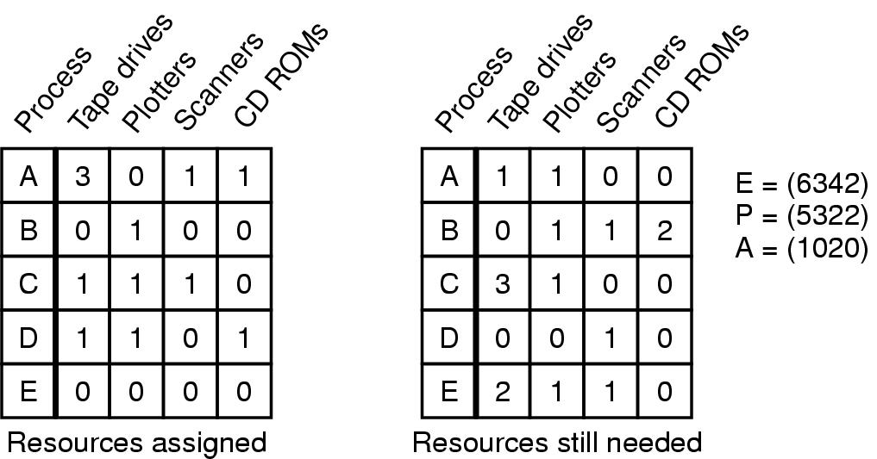
Banker's Algorithm for multiple resources
Example of banker's algorithm with multiple resources

Slide 259
Starvation
Algorithm to allocate a resource (akin to scheduling)
Give the resource to the shortest job first
Works great for multiple short jobs in a system
May cause long jobs to be postponed indefinitely
Solution
First-come, first-serve policy
Starvation can lead to deadlock
Process starved for resources can be holding (other) resources
If those resources aren’t used and released in a timely fashion, shortage could lead to deadlock
Is this in general or for deadlocks?

